Slide 1
New laws from the 86th Legislative session national educators law institute spring Conference June 11-12, 2019
Sarah Orman, Senior Attorney
TASB Legal Services

Slide 2
Top 8 topics
Threats
Privacy
Mental Health Support
Suicide Prevention
Discipline Management
Safety Planning
Security Personnel
Special Education

Slide 3
2019 legislation
Senate bill 11
New funds for safety initiatives
Effective 2019-20
Extensive rulemaking
TEA and TxSSC do not have to act absent funding

Slide 4
Threats

Slide 5
Threat Assessment teams
SB 11
Boards must:
Set team for each campus; teams may serve multiple campuses; district may have oversight team
Set policies and procedures based on TxSSC guidance
Teams must have relevant expertise (counseling, mental health, safety, law enforcement, etc.)
Teams must undergo training by TxSSC or ESCs
Teams have extensive reporting requirements

Slide 6
When is assessment required?
Harmful, threatening, or violent behavior includes behaviors, such as verbal threats, threats of self harm, bullying, cyberbullying, fighting, the use or possession of a weapon, sexual assault, sexual harassment, dating violence, stalking, or assault, by a student that could result in:
specific interventions, including mental health or behavioral supports;
in-school suspension;
out-of-school suspension; or
the student's expulsion or removal to DAEP or JJAEP

Slide 7
What does team do?
Assess and report individuals exhibiting threatening behavior
Gather data to determine risk and intervention
Refer individuals for mental health assessment
Implement an escalation program as appropriate

Slide 8
Team Determinations
SB 11
On a determination that a student or other person poses a threat of violence to self or others, a team must immediately report to the superintendent.
If the individual is a student, the superintendent must immediately attempt to inform the parent.
The parental notice requirement does not prevent a school employee from acting immediately in response to an imminent threat or emergency

Slide 9
Parental Notification
SB 11
SB 11 requires district to:
provide notice as soon as possible to parents
in the event of a bomb threat or terroristic threat

Slide 10
Parental Notification
SB 11
SB 11 requires emergency operation plan (EOP) to:
provide for immediate notification to parents in circumstances involving a significant threat to the health or safety of students; and
name the individual with responsibility for overseeing notification

Slide 11
Privacy

Slide 12
Privacy and security
Notes:
https://www.brennancenter.org/analysis/school-surveillance-zone
In an attempt to quantify expenditures on social media monitoring software by school districts, the Brennan Center examined contracts for such software using SmartProcure, a database of government purchase orders. Our review is based on self-reported procurement orders in the database, and thus likely depicts only a portion of school spending on these tools. According to these data, school spending on social media monitoring software has grown in recent years. As the graph below indicates, the database shows 63 school districts across the country purchasing social media monitoring software in 2018, up from just six in 2013 — more than a tenfold increase. This is, to be sure, still a small number compared to the over 13,000 school districts across the country. But it likely does not tell the whole story. Social Sentinel itself has touted the fact that it serves “thousands of schools in more than 35 states” – a far larger number of states, and thus more school districts, than are reflected in SmartProcure’s database. And some school districts known to have purchased social media monitoring technology represent tens or even hundreds of thousands of students; Orange County, FL, which purchased these tools in 2015, 2016, and 2018, has more students than Little Rock, Arkansas, has people.
Brennan Center says little evidence that effective, but anecdotally I have heard of two averted suicides involving Texas districts.
This is a serious, but understandable, trade off.

Slide 13
Ferpa Exceptions
Directory
information
School official with legitimate reason
Subpoena
Health and safety
Notes:
Definition of an education record: maintained by the district and directly related to a student. We will discuss some of the exceptions in a minute.

Slide 14
Disclosure if threat is made
Q: Can we disclose student records without consent in the event of a campus threat?
A: Yes, when disclosure to appropriate parties is necessary in order to protect the health and safety of the student or others from a specific and articulable threat.
Notes:
You have to have an exception to FERPA because these are not district employees. Health and safety emergency is one exception, but you may need your threat assessment team to evaluate a threat first in order to determine that it is a true health and safety emergency. So best practice is to designate these individuals as school officials. TASB FL(L) is broad enough to include these individuals as “volunteers” or “contractors” performing a district function. They also need to be subject to FERPA use and disclosure rules and under district’s direct control. This should be part of agreement for members of the team.

Slide 15
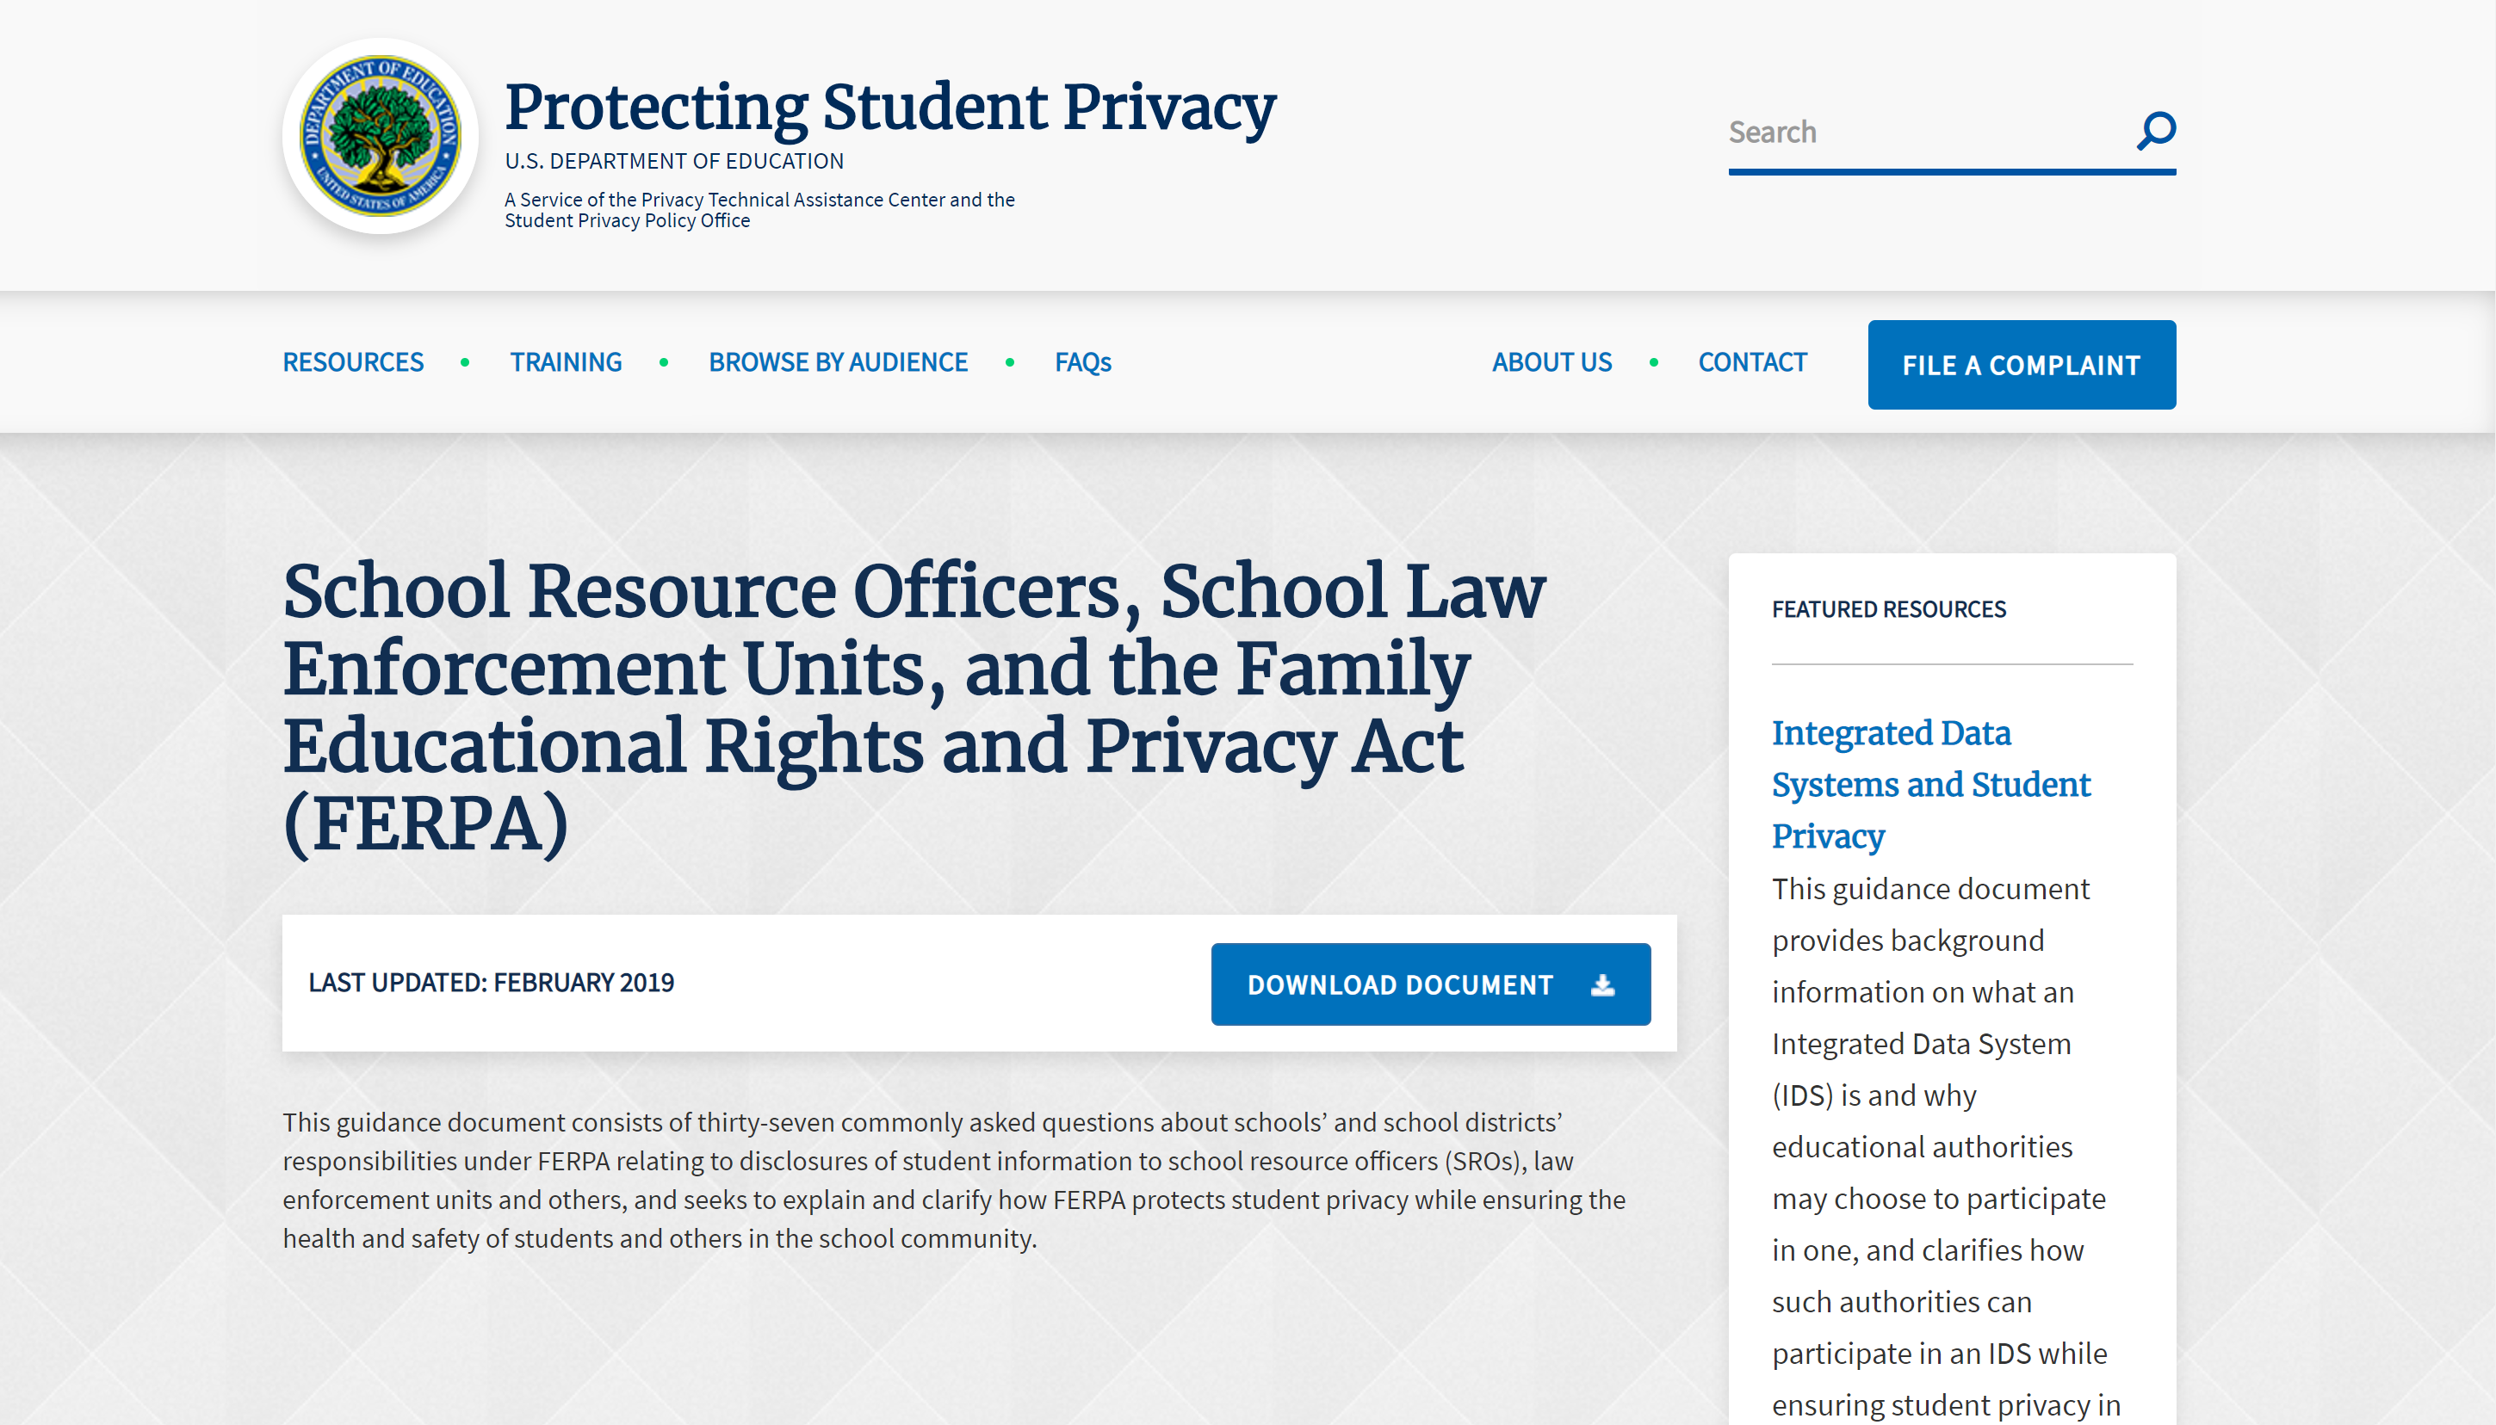
Notes:
FAQ discusses how a district can share student info with people on a threat assessment team, including law enforcement or parent volunteers. Also sharing information with law enforcement. Very relevant to the reason we are all here today. Link in your handout.
Among the questions addressed – How SROs can be considered school officials. When to use the health and safety emergency.

Slide 16
Disclosure to threat assessment team
Q: May we disclose a student’s education records to outside law enforcement officials or mental health officials who serve on a threat assessment team?
A: Yes, if the members of the threat assessment team meet the criteria under FERPA for school officials.
Notes:
You have to have an exception to FERPA because these are not district employees. Health and safety emergency is one exception, but you may need your threat assessment team to evaluate a threat first in order to determine that it is a true health and safety emergency. So best practice is to designate these individuals as school officials. TASB FL(L) is broad enough to include these individuals as “volunteers” or “contractors” performing a district function. They also need to be subject to FERPA use and disclosure rules and under district’s direct control. This should be part of agreement for members of the team.

Slide 17
When can a Nonemployee qualify as a school official under FERPA?
Performs a service for which the district would otherwise use an employee;
Under district’s direct control with respect to use and maintenance of the education records;
Subject to FERPA’s use and re-disclosure requirements;
Designated in policy and annual notice.
Notes:
Have your threat assessment team members sign an agreement to document their responsibilities for safeguarding information under FERPA and the district’s direct control over their use of student education records.
If these criteria are met, the outside members of your threat assessment team can help you determine if there is a health and safety emergency.
Keep in mind they also have to have a legitimate educational interest. That means they need access to the record in order to do their job.

Slide 18
Information sharing with law enforcement
SB 2135
When law enforcement sends notice of arrest, must include whether to do threat assessment or safety plan.
District can request more info, but that info cannot be used for discipline.
District can see confidential law enforcement records.

Slide 19
Mental
Health
Support

Slide 20
health curriculum
Mental health added to required health instruction
Digital Citizenship Curriculum will include information about cyberbullying
Notes:
Mental health added to required health instruction. Also Digital Citizenship Curriculum including info regarding potential criminal consequences of cyberbullying.

Slide 21
Requires a comprehensive counseling program. Parents are entitled to a preview.
Continuing education expanded to “at least” 25% to include training on instruction for special populations, students with mental health conditions, and who engage in substance abuse.
Must have training on suicide prevention, bullying prevention, grief and trauma informed care. May have training on PBIS.
May employ nonphysician mental health professionals.
HB 18

Slide 22
Consent to treatment

Slide 23
Parental consent
Written parental consent is generally required before a district may conduct a psychological examination, test, or treatment.
Child abuse and special education laws may provide an exception. Tex. Educ. Code § 26.009.

Slide 24
Outside referral
Referral to outside counselor for care or treatment of a chemical dependency or an emotional or psychological condition requires:
Prior written consent from a parent, guardian, or managing conservator;
Disclosure of any relationship between district and outside counselor;
Information regarding any alternative public or private source of care reasonably available in the area;
Approval of appropriate district personnel before a student may be referred for care or treatment or before a referral is suggested as being warranted;
Specifically prohibiting any unlawful disclosure of a student record.
Tex. Educ. Code § 38.010.

Slide 25
Parental Consent
SB 11
SB 11 requires district to:
Seek consent from parents on district form that complies with FERPA and HIPAA
Specify whether one time or course of treatment

Slide 26
Minor’s consent
A minor can consent to counseling for:
suicide prevention; chemical addiction or dependency; or sexual, physical, or emotional abuse.
Tex. Fam. Code § 32.004; TASB Policy FFE(LEGAL)

Slide 27
Professional authority
A licensed or certified physician, psychologist, counselor or social worker having reasonable grounds to believe that a minor is legally able to consent to counseling may:
Counsel the child without parental consent;
Advise parent of given or needed treatment without the minor’s consent;
Rely on the child’s written statement regarding grounds for consent to counseling. Tex. Fam. Code § 32.004

Slide 28
Screening students
Do not require psychiatric evaluation or psychotropic drug as condition of attending school. Tex. Educ. Code § 38.016.
Nonphysician mental health professionals, nurses, and other medical personnel may refer for medical screening.
Notes:
I think the addition of nonphysician mental health professionals is new.

Slide 29
Return to school
Remember child find duties.
Treat re-entry after hospitalization the same as physical health issues.
TEA is now lead source for training and resources for schools on mental health supports and suicide prevention, including resources on best practices for a student’s return to school following mental health treatment.

Slide 30
Trauma
Informed
Care

Slide 31
New Policy on Trauma
SB 11
New policy must be adopted and included in the district improvement plan.

Slide 32
Required Training
Required continuing education requirements for a classroom teacher must include instruction regarding how grief and trauma affect student learning and behavior and strategies for academic success.
Commissioner must approve the training.

Slide 33
New emphasis on psych wellbeing in eop
SB 11
EOP must provide for psychological safety of students, staff, and the community during a recovery. EOPs must:
Be aligned with best practices identified by the TDSHS
Ensure staff get required training on suicide prevention and grief-informed and trauma-informed care
Integrate psychological safety strategies like psychological first aid training
Include strategies and procedures for integrating and supporting physical and psychological safety that align with the EOP and trauma-informed policies

Slide 34
Substance abuse
New TEA resources
SHAC must address
Now part of health curriculum and district improvement plan as an aspect of overall mental health

Slide 35
Suicide Prevention

Slide 36
Suicide Statistics
Suicide is the second leading cause of death among Americans aged 10-24
Males die by suicide nearly 4 times more often than females
Females are more likely to report suicidal thoughts
Youth who identify as LGTBQ are 4 times as likely as others to attempt suicide
Notes:
Switching topics – I am not an expert or a psychologist. Just going to review some basics from a legal perspective.
See Suicide Facts at a Glance 2018, Suicide Awareness Voices of Education (SAVE), https://save.org/about-suicide/suicide-facts/; and Suicide Facts at a Glance 2015, CDC, https://www.cdc.gov/violenceprevention/pdf/suicide-datasheet-a.pdf.
No longer a taboo topic.

Slide 37
Shac Duties
SB 11
HB 18
Recommending health instruction on, mental health, suicide prevention, and substance abuse
Raising parental awareness of risky behaviors and local resources
New required statements about available services

Slide 38
Threat Assessment for suicide
If an Assessment team determines that a student presents a risk of suicide, the district must use its suicide prevention policy.

Slide 39
District Policy FFB
Local practices and procedures for mental health and suicide intervention must:
Have procedures to notify parents of early warning signs
Prohibit medical screening without parental consent
Set out available counseling alternatives

Slide 40
Notes:
8 minute video on TxSSC website. Best practices based on model policy from SPRC (Suicide Prevention Resource Center.) Evidence and research-based.

Slide 41
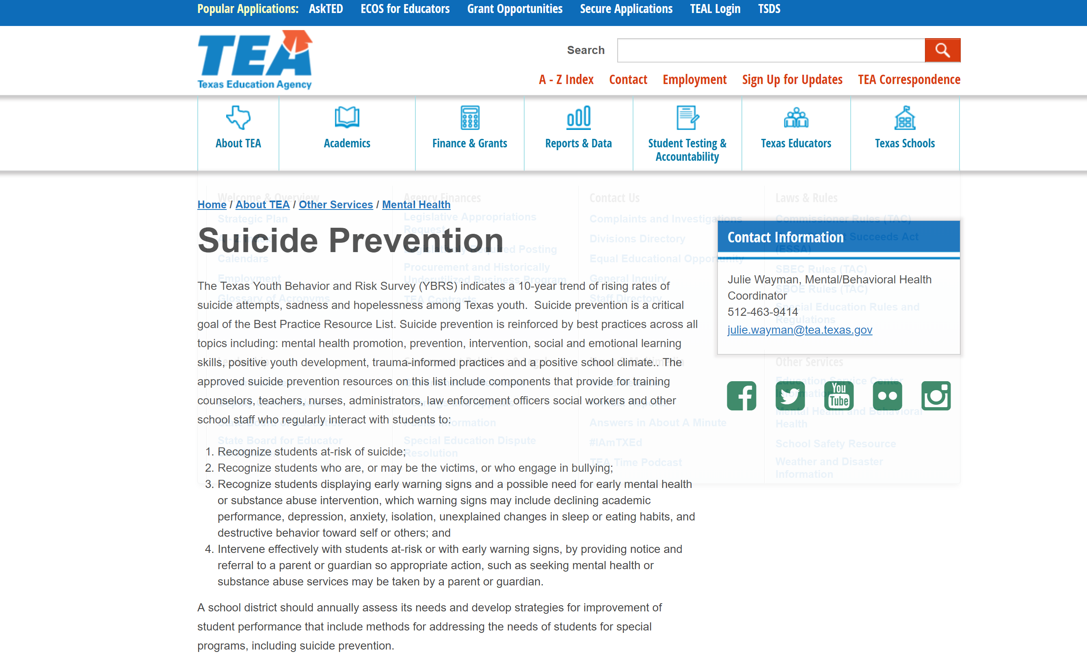
Notes:
State law requires TEA to have a list of best practices for mental health training, including suicide prevention. You can find links to approved training on their suicide prevention page.

Slide 42
School liability for suicide
Q: Can a district be held liable when a student who was bullied dies by suicide?
A: Not likely, but a court could find that the district responded with deliberate indifference if the bullying included harassment based on a protected characteristic.

Slide 43
Discipline
Management

Slide 44
2019 legislation
Data collection on suspension (HB 65)
Mitigating factors now include foster care and homelessness (HB 811)
No OSS if homeless (HB 692)
Must post CBC contact info online (SB 1306)
Coursework to students in ISS and OSS (HB 3012)
DAEP, JJAEP, or TJJD must give notice and campus must have plan for transition back to campus (HB 2184)

Slide 45
New focus on Threats and harassment
JJAEPs must admit discretionary expulsion for terroristic threat
(HB 3012)
Mandatory DAEP for certain threatening or harassing behavior to an employee
(SB 2432)

Slide 46
Personnel management
HB 3630
SB 1451
No aversive techniques
No deficiency based on removal
No employee or volunteer may apply an aversive technique
Defined as act intended to reduce likelihood of misbehavior through significant physical or emotional discomfort
13 examples in law
No T-TESS deficiency based solely on disciplinary removals or teacher’s documentation of reason for removal.
Teacher can be rated deficient based on observation or substantiated reports.

Slide 47
Safety
Planning

Slide 48
New provisions Multihazard EOP
SB 11
Adds “prevention” to content of EOP
Requires classroom access to a phone or other device for immediate contact with emergency services
Requires measures to ensure district communications technology and infrastructure are adequate for emergencies

Slide 49
more Provisions Multihazard EOP
SB 11
Chain of command
Physical and psychological safety
Portable buildings
Students and staff with disabilities
Parental notice
Substitute teachers
Security committee

Slide 50
Failure to adopt eop
SB 11
Public hearing
Commissioner may appoint board of managers

Slide 51
Facilities standards
SB 11
Commissioner must adopt building standards and review every other year.
Purpose is to ensure safety and security.

Slide 52
Local safety and security committee
SB 11
If possible, committee should include:
(1) city or county office of emergency management
(2) local police or sheriff
(3) ISD police, if applicable;
(4) board president
(5) another board member
(6) superintendent
(7) superintendent’s designee(s), with at least one classroom teacher
(8) charter school representative, if district partners with OECS; and
(9) two parents.

Slide 53
Local safety and security committee
SB 11
In addition to existing duties, committee must:
Comply with the OMA
Meet 3 times/year (each semester + summer)
Recommend updates to EOP
Consult with law enforcement about increasing presence

Slide 54
Mandatory Drills
SB 11
The commissioner (in consultation with the TxSSC) will adopt rules:
(1) providing procedures for evacuating and securing school property during an emergency; and
(2) designating the number of mandatory school drills to be conducted each semester of the school year, not to exceed eight drills, including designating the number of:
(A) evacuation fire exit drills; and
(B) lockdown, lockout, shelter-in-place, and evacuation drills.

Slide 55
Security
Personnel

Slide 56
Training for school Based Police
SB 11
Developed by TCOLE
Focus is on interactions with school-age populations
Required within 180 days (or Aug. 31, 2020)
NOT required for SROs

Slide 57
Limited role for all School Police
SB 1707
Board must set law enforcement duties
Must be in all relevant documents, including MOU, district improvement plan, and SCOC
Must be limited to law enforcement role of protecting safety and property
Must not include routine student discipline or administrative tasks

Slide 58
School Marshals
HB 1387
No more cap on number per campus

Slide 59
Special Education

Slide 60
Required parental notice
SB 139
SB 2075
Developed by TEA
Notify parent of student with dyslexia or related disorder of TSLAC audiobook program
Notify parents of all students of change in PBMAS reporting in 2016-17; provide information about referrals and evaluations

Slide 61
Hemp
HB 1325 & 3703
Hemp and hemp-derived products like CBD oil legalized as long as they contain less than .3% THC
Texas Compassionate Use Act expanded to new conditions (seizure disorder, MS, spasticity, ALS, autism, terminal cancer, incurable neurodegenerative disease)

Slide 62
© 2019 Texas Association of School Boards, Inc. All rights reserved.

Slide 63
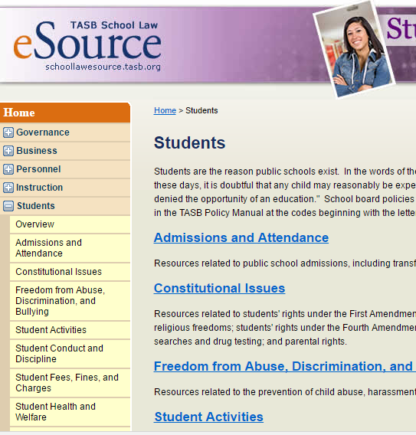
Thank you! Questions?
Call the Legal Line at
800.580.5345
Follow us @tasblegal
Look for answers on eSource or your TASB resources
Email us at
legal@tasb.org
Notes:
Twitter

