Slide 1
The Good, The Bad, and the Ugly: How to Handle any ARD Situation
Denise Hays
Attorney-at-Law / Shareholder
© 2019: Walsh Gallegos Treviño Russo & Kyle P.C.

Slide 2

The Basics: ARD 101
2

Slide 3
Strategy 1: Respect and Understand
a Parent’s Legally Recognized Rights Under IDEA
3

Slide 4
What has the Supreme Court said about a parent’s role under IDEA?
“The core of the statute, however, is the cooperative process that it establishes between parents and schools.” School districts have a “natural advantage” in information and expertise, but Congress addressed this when it obliged schools to safeguard the procedural rights of parents and to share information with them. Schaffer v. Weast, 126 S. Ct. 528, 536 (2005).
4

Slide 5
What are parents’ rights under the law?
Right to a Due Process Hearing (DPH)
Right to Prior Written Notice
Right to be a part of the ARD Committee
Right to Consent
Right to Revoke Consent
Right to Place their child in Private School
Right to Inspect and Review Records
Right to an IEE
Right to a copy of Notice of Procedural Safeguards
5

Slide 6
What were you really thinking…?
Parent asks that all (eight) of the child’s teachers be present at the ARD meeting.
What is the best practice?
6

Slide 7
What were you really thinking…?
Parent’s invitee becomes loud and takes over the meeting.
What is the best practice?
7

Slide 8
What were you really thinking…?
Mother wants to keep child’s biological father from attending meeting.
What is the best practice?
8

Slide 9
Strategy 2: Do Not Compromise Professional Judgment in an Effort to Reach Consensus with the Parent at an ARD Committee Meeting
9

Slide 10
What were you really thinking…?
Parent requests the child be in all general education classes and only work on academic goals even though the child has functional and behavioral needs (very low cognitive functioning).
What is the best practice?
10

Slide 11
So you disagree…what do the Commissioner’s Rules outline as the next steps?
“All members of the ARD committee must have the opportunity to participate in a collaborative manner in developing the IEP. A decision of the ARD committee concerning required elements of the IEP must be made by mutual agreement if possible. The ARD committee may agree to an annual IEP or an IEP of shorter duration.” 19 Tex. Admin. Code § 89.1050(g).
11

Slide 12
And the next steps…
“When mutual agreement about all required elements of the IEP is not achieved, the parent who disagrees must be offered a single opportunity to recess and reconvene the ARD committee meeting. The period of time for reconvening the ARD committee meeting must not exceed ten school days, unless the parties mutually agree otherwise. The ARD committee must schedule the reconvened meeting at a mutually agreed upon time and place.” 19 Tex. Admin. Code 89.1050(g)(1).
12

Slide 13
During the recess…
“…consider alternatives, gather additional data, prepare further documentation, and/or obtain additional resource persons who may assist in enabling the ARD committee to reach mutual agreement.” 19 Tex. Admin. Code § 89.1050(g)(2)
13

Slide 14
Oh no nothing works…what is Plan B?
“…the school district must implement the IEP that it has determined to be appropriate for the student.” 19 Tex. Admin. Code § 89.1050(g)(3).
When mutual agreement is not reached, a written statement of the basis for the disagreement shall be included in the IEP.
Don’t forget Prior Written Notice! 34 CFR § 300.503.
Parents shall have the right to file a complaint, request mediation, or request a due process hearing at any point when they disagree with the decisions of the committee.
14

Slide 15
Can’t the ARD Committee just give the parents what they want?
Remember that the school remains responsible for providing FAPE, not the parent.
While it is admirable for schools to attempt reaching resolution with families, it should never be at the cost of doing what is appropriate for the child.
15

Slide 16
A Great Response to Any Questionable Request
“We’d like to conduct an evaluation to determine if your child needs that service in order to receive a FAPE.”
This response has four key elements:
The evaluation, not administrative concerns, will drive the decision;
The evaluation will focus on what the student needs, not just what will benefit the student;
An appropriate education, but not the best possible education, is what is needed for FAPE; and
The evaluation will be conducted by the school.
16

Slide 17
Strategy 3: Ensure that Parents Are Afforded Meaningful Participation as Defined by Law
17

Slide 18
What is “meaningful participation”?
“Meaningful participation” is not the right to a line-item veto.
The District does not have to adopt the parent’s recommendations, but it does have to consider them. Meaningful participation means the ability to participate in the process, not the right to dictate an outcome. White v. Ascension Parish, 343 F.3d 373 (5th Cir. 2003).
Would include considering an independent evaluation, discussing placement options, and answering parents’ questions.
Don’t force the school’s position without considering other options.
18

Slide 19
Collaborate and Coordinate with Key Stakeholders
The Fifth Circuit has a four-part test to determine whether an IEP is reasonably calculated to provided a meaningful educational benefit (and thus, confer FAPE). Those four factors are:
The program is individualized on the basis of the student’s assessment and performance
The program is administered in the least restrictive environment
The services are provided in a coordinated and collaborative manner by the key stakeholders
Positive academic and non-academic benefits are demonstrated. Cypress-Fairbanks ISD v. Michael F. , 118 F.3d 245, 253 (5th Cir. 1997).
19

Slide 20
Parents are Part of the “key stakeholders”
Collaboration and coordination occurs when parents participate. The Fifth Circuit indicates that a District does not satisfy its responsibility for parental participation if there is “bad faith exclusion” of the parents or a refusal to listen to or consider input from the parents. White v. Ascension Parish, 343 F.3d 373 (5th Cir. 2003).
20

Slide 21
How does “Meaningful Participation by Parents” interplay with the provision of FAPE?
A parent may successfully argue that a child was denied FAPE if procedural violations “significantly impeded the parent’s opportunity to participate in the decision-making process regarding the provision of FAPE to the parent’s child.” 34 C.F.R. § 300.513 (a)(2)(ii).
21

Slide 22
What were you really thinking…?
Parent says school has denied them an opportunity to meaningfully participate in the ARD process. You have convened over eight ARD Committee meetings, the duration of which was over three hours each and parents had two Advocate in tow.
What is the best practice?
22

Slide 23
What were you really thinking…?
The Diagnostician sends an email stating see student’s IEP for upcoming ARD meeting, it is a done deal, we just need your signatures. Have an amazing day.
What is the best practice?
23

Slide 24
What is predetermination?
Predetermination occurs when a school district has made its determination prior to the ARD Committee meeting. For example, the district presents only one placement option at the meeting and proves to be unwilling to even consider or discuss other alternatives.
Predetermination is a procedural violation of the law.
24

Slide 25
What were you really thinking…?
You have attempted to schedule an ARD Committee meeting with the parents for over two months. The parent has either indicated that her Advocate is in a coma and she can’t come unrepresented, or she’s been selected as a participate in a recent episode of Antiques Roadshow so she can’t nail down a date at this time. An annual is right around the corner.
What is the best practice?
25

Slide 26
What were you really thinking…?
Parent sends an email informing all school personnel that no meetings may take place regarding her child unless she is present. Must the school abide by the parent’s request? As far as she is concerned, staffings are secret meetings that she will never endorse. She would be happy however to send her Advocate to any staffings.
What is the best practice?
26

Slide 27
Strategy 4: Maintain Diplomacy and Professionalism at All Times Despite Level of Difficulty
27

Slide 28
What were you really thinking…?
A parent does not want to sign “agree” or “disagree” after a four-hour ARD. She wants to think about it. The Advocate wants to meet with another Advocate. They should have an answer buy Monday but there are no guarantees. How should the school respond?
What is the best practice?
28

Slide 29
What were you really thinking…?
Parent requests the deliberations (or minutes) be read at the end of each ARD committee meeting. Parent then demands certain words be changed, included, or excluded, in particular they want the minutes to reflect an entire team is a group of incompetent educators and wants that reflected. The Advocate sees the deliberations as an opportunity to indict school personnel.
What is the best practice?
29

Slide 30
What were you really thinking…?
Parent walks into the ARD Committee meeting walking around the room with her smart phone , videotaping each ARD participant as they speak. She particularly has an affinity for close ups of any teacher when discussing her child.
Your teachers at this point are feeling highly uncomfortable.
What is the best practice?
30

Slide 31
Strategy 5: Defend the Correct Application of the Law and Follow Recent Court Decisions
31

Slide 32
One-on-one aide with a twist
Meares v. Rim of the World USD, 69 IDELR 38 (C.D. Cal. 2016)
“By failing to provide for a male aide, the District’s IEP did not offer a placement that met Plaintiff’s ‘unique needs’ under the IDEA, and thus denied Plaintiff a FAPE.” The record showed that the student had a pattern of violence aimed at female staff members, and generally related better to men.
32

Slide 33
Proceeding to ARD without the Parent
A.L. v. Jackson County School Board, 66 IDELR 271 (11th Cir. 2015)
The court held that the district did not violate the parent’s rights or IDEA when it held an IEP Team meeting without the parent. The district had attempted to schedule the meeting for several months, and the parent was consistently not available. The parent called in sick on the day of the meeting and the district insisted on going forward, due to the needs of the student. The district offered to include the parent by telephone, and the parent refused.
33

Slide 34
The Case of Inflexible Parent / Advocates
Rockwall ISD v. M.C., 67 IDELR 108 (5th Cir. 2016)
The court concluded that the parents had taken an inflexible “all or nothing” approach at the ARDC (IEP Team) meeting. Dissatisfied with the district’s proposed placement of their daughter, the parents sought reimbursement for private school tuition. They won their case before the special education hearing officer, but Rockwall appealed into federal court. The federal district court ruled for the district, and now the 5th Circuit has affirmed.
The court’s opinion notes that the parents and their advocate frequently voiced their questions and ideas during the ARD meeting, and that “RISD officials repeatedly revised the language of their proposal to incorporate the parties’ suggestions.” The court concluded that it was the parents who refused to return to the table to complete the work on the IEP unless the district agreed to their plan. Districts are sometimes accused of going into ARDC meetings with a “predetermined” mindset. Here, it was the other way around.
34

Slide 35
Wait, wait, we’re not done yet…
Pangerl v. Peoria USD, 69 IDELR 133 (D.C. Ariz. 2017)
The court held that the parent was not denied meaningful participation, even though the IEP Team finished writing the IEP after the parent left the meeting. The court carefully distinguished the fact situation here from the facts in Doug C. v. Hawaii DOE, a 9th Circuit decision cited by both parties. Here, the Team scheduled the meeting for two hours. The parent was accompanied by two advocates. One of the advocates said from the beginning that she could not stay longer than the two hours. When the two hour mark arrived, the IEP was not complete. The parent and advocates left the meeting and the rest of the team completed the process because the existing IEP was set to expire in a few days. The district representative informed the parents, before she left, that the team would complete the process, but that they would also reconvene to make changes to the IEP.
35

Slide 36
Predetermined? Not really!
S.H. v. Tustin USD, 69 IDELR 176 (9th Cir. 2017)
This is a case where the parents allege that the district predetermined placement and denied them meaningful participation in the process. The context was a change of placement proposed by the school after six IEP Team meetings. The court ruled for the district. Key Quote:
The record clearly shows that Appellants were provided adequate—and arguably extraordinary—opportunities to participate in the placement decision. Appellants visited the proposed placement multiple times, before and after the placement decision. And at least one of the Appellants attended and participated in every IEP meeting, effecting many changes to the plan.
Comment: As seems typical, the “denial of meaningful participation” here was made by parents deeply involved in the process.
37

Slide 37
Timing of the IEP
A.L. v. Alamo Heights ISD, 73 IDELR 71 (W.D. Tex. 2018)
The court held that the district had an IEP in place at the beginning of the school year, as required by law. The problem was that the parent disagreed with the proposed IEP at an ARDC meeting held just before the start of the school year. So the district provided Prior Written Notice, informing the parent that the previous year’s IEP would be continued until the ARDC could agree on new goals. Good enough
38

Slide 38
Overly ambitious is not appropriately ambitious
E.R. v. Spring Branch ISD, 73 IDELR 112 (5th Cir. 2018)
The parents argued that the IEP was fatally flawed because it only addressed the student’s “critical needs” and did not include every grade level TEKS standard for 4th grade. But the court noted that “providing [the student] with every single TEKS strand and standard would not have been individualized. To the contrary, excessive goals could have put her in a position where success would have been exceedingly unlikely.”
39

Slide 39
Meaningful Participation and Then Some!
F.L. v. Board of Education of the Great Neck Union Free School District, 72 IDELR 232 (2nd Cir. 2018)
The hearing officer had ruled that the district committed a procedural error when it “consistently disregarded the father’s concerns.” The district court overturned that decision and here, the Circuit Court affirms, noting that “the audio recordings and over 500 pages of transcripts of those recorded meetings” made it clear that the father’s concerns were listened to. There were at least eight IEP Team meetings with at least 10 people at each meeting.
Comment: Eight meetings, with ten people at each. Audio recordings that were transcribed, producing over 500 pages. And the father claims that no one listened. Worse than that, the initial hearing officer failed to recognize the difference between being listened to vs. getting what you want. Parents are entitled to the former, but not the latter.
40

Slide 40
What about the dissenting member of our team?
Letter to Zirkel, 72 IDELR 46 (OSEP 2018)
OSEP says that IDEA does not give guidance on whether or not the opinions of a dissenting member of the IEP Team should be included in the student’s record. However, in the context of the evaluation of a student for a specific learning disability there is a provision calling for members of the team who disagree to submit a written statement. As to other situations, IDEA does not speak to it, so it is up to state and/or local policy.
41

Slide 41
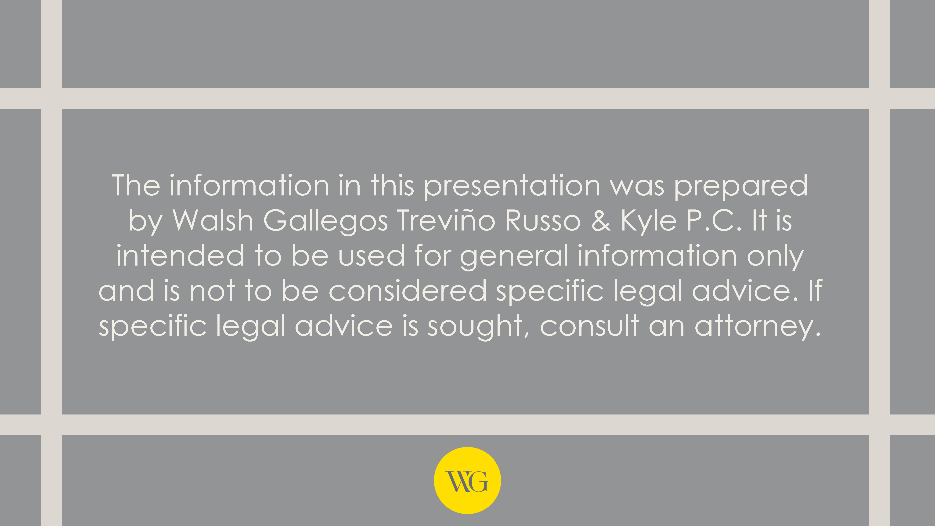
© 2019: Walsh Gallegos Treviño Russo & Kyle P.C.

