Slide 1

Things to Know Before Calling the SRO
Holly Boyd Wardell
www.edlaw.com

Slide 2
IDEA – Referral to and action by law enforcement and judicial authorities.
“Nothing in [Part B] shall be construed to prohibit an agency from reporting a crime committed by a child with a disability to appropriate authorities or to prevent State law enforcement and judicial authorities from exercising their responsibilities with regard to the application of Federal and State law to crimes committed by a child with a disability.”
20 U.S.C. §1415(k)(6); 34 C.F.R. 300.535(a).

Slide 3
A district does not have to notify the parents or otherwise comply with the IDEA’s procedural safeguards prior* to reporting a crime.
64 Fed. Reg. 12,631 (1999).
*Afterward must transmit records to appropriate authorities per 34 C .F.R. §300.535(b).

Slide 4
34 C.F.R. §300.535(b)
Transmittal of Records
An agency reporting a crime committed by a child with a disability must ensure that copies of the special education and disciplinary records of the child are transmitted for consideration by the appropriate authorities to whom the agency reports the crime.
An agency reporting a crime under this section may transmit copies of the child’s special education and disciplinary records only to the extent the transmission is permitted by the Family Educational Rights and Privacy Act.

Slide 5
34 C.F.R. §300.535(b)
Transmittal of Records
Dear _______________:
Your child was recently involved in an incident at school for which law enforcement officials were contacted. Federal law requires the school district to transmit copies of your child’s special education and discipline records to law enforcement officials who may be considering your child’s case. In order to do so, we need your permission.
If you would like for us to send copies of your child’s last full, individual evaluation (FIE) and individual education plan (IEP), please sign the enclosed form and return it to us within the next ten business days. If you do not sign and return the enclosed form, we will not transmit the records. Please contact me if you have any questions.
Sincerely,

Slide 6
Does a request for police intervention implicate FAPE?

Slide 7
Katy ISD - 2007
Spring Branch - 2016
“[A] school district’s right and ability to report alleged crimes by children with disabilities to appropriate authorities is neither a component of nor a factor in determining whether a student’s IEP or [BIP] is appropriate and the removal of a child from school solely for this reason is not actional under the IDEA.”
School violated IDEA and denied FAPE, because calls to the police were inconsistent with the IEP’s expressly authorized strategies of using a calm interaction style, minimizing verbal interactions, providing access to a cooling off period, and avoiding power struggles.
Dkt Nos. 004-SE-0906; 039-SE-1006; 154-SE-0207; 256-SE-0507
Dkt No. 068-SE-1015

Slide 8
Spring Branch ISD – Hearing Officer Decision
The IDEA specifically allows school districts to refer students with disabilities to law enforcement and juvenile authorities notwithstanding their disability status. However, where a student with a disability clearly does not pose a threat of harm to ***self or others, school personnel should first implement the behavioral interventions contained in Student’s IEP before calling the police. The record is silent either as to whether Student posed a threat of harm to ***self or others or whether the IEP behavioral interventions were attempted before police intervened at [campus.]
Dkt No. 068-SE-1015

Slide 9
Spring Branch ISD – Hearing Officer Decision
The District’s expert witness in behavior management believed it was not appropriate for police to be called to intervene with Student in the classroom but did not explain why.
Hearing Officer: ordered $50,250 tuition and tutoring costs for Student’s unilateral placement at Fusion Academy.
Dkt No. 068-SE-1015

Slide 10
Spring Branch ISD – Federal District Court (2018)
[C]ampus police were summoned on at least four occasions to deal with O.W.’s outbursts, the last occasion being so traumatic for O.W. that he was placed on shortened school days for the last twenty days of the school—an alteration done without ARDC consideration or approval.
2018 WL 2335341

Slide 11
Spring Branch ISD – Federal District Court (2018)
SBISD argues that [calling the police is] allowed in emergency situations. Though the Court does not directly take issue with this assertion, it does take issue with the assertion that emergency situations occurred frequently enough to justify such numerous uses of restraints or police interventions. Either SBISD’s failure to follow the procedures in O.W.’s IEP were causing escalations and creating “emergency situations,” thereby denying O.W. a FAPE, or the procedures in the IEP were inappropriate given SBISD’s inability to prevent up to twelve emergency situations in forty days. Either way, SBISED failed to provide O.W. a FAPE.
2018 WL 2335341

Slide 12
Spring Branch ISD – Fifth Circuit (2019)
On at least four occasions, Ridgecrest summoned police as a result of O.W.’s behavior. However, because O.W. often calmed down before the police arrived, it appears that the police spoke with O.W. only once.
938 F.3d 695

Slide 13
Spring Branch ISD – Fifth Circuit (2019)
[P]olice were summoned after teachers attempted de-escalation….O.W. repeatedly struck his teacher with a closed fist and then charged at her; and the teachers restrained O.W. Upon entering the classroom, the officer “stated to O.W. who was in charge, and [then] asked if he wanted to go to jail.” The officer also asked if O.W. “remembered why he was in a cop car last time.”
938 F.3d 695

Slide 14
Spring Branch ISD – Fifth Circuit (2019)
Because the School District took steps to avoid police interaction and O.W.’s behavior posed a substantial risk of serious injury to himself and others, we do not believe the calls to police were inconsistent with O.W.’s IEP. Accordingly, the single instance of police involvement did not rise to the level of an actionable violation.
938 F.3d 695

Slide 15
TEXAS RESTRAINT RULES
STUDENTS WITH DISABILITIES
Rules and procedures apply to a peace officer if:
is employed or commissioned by a school district; or
provides, as a school resource officer, a regular police presence on a school district campus under a memorandum of understanding between the district and a local law enforcement agency.
Documentation
Notice to Parent
Tex. Educ. Code §37.0021(h).

Slide 16
Tex. Educ. Code §37.0021 does not apply to:
A peace officer, while performing law enforcement duties, except as provided above;
Juvenile probation, detention, or corrections personnel; or
An educational services provider with whom a student is placed by a judicial authority, unless the services are provided in an educational program of a school district.
Tex. Educ. Code §37.0021(h).

Slide 17
“Law enforcement duties” means activities of a peace officer related to the investigation and enforcement of state criminal laws and other duties authorized by the Code of Criminal Procedure.
Tex. Educ. Code §37.0021(b)(4),(g).

Slide 18


SCHOOL RESOURCE OFFICERS
CONVENTIONAL LAW ENFORCEMENT TRAINING & EXPERIENCE
PARADIGM SHIFT: SCHOOL SETTING

Slide 19
BODY CAMs
Usually inactive while SRO is on school grounds/activity
Activated during law enforcement specific contacts
May be property of local PD/ISD PD
May or may not subject to disclosure under the Texas Public Information Act

Slide 20
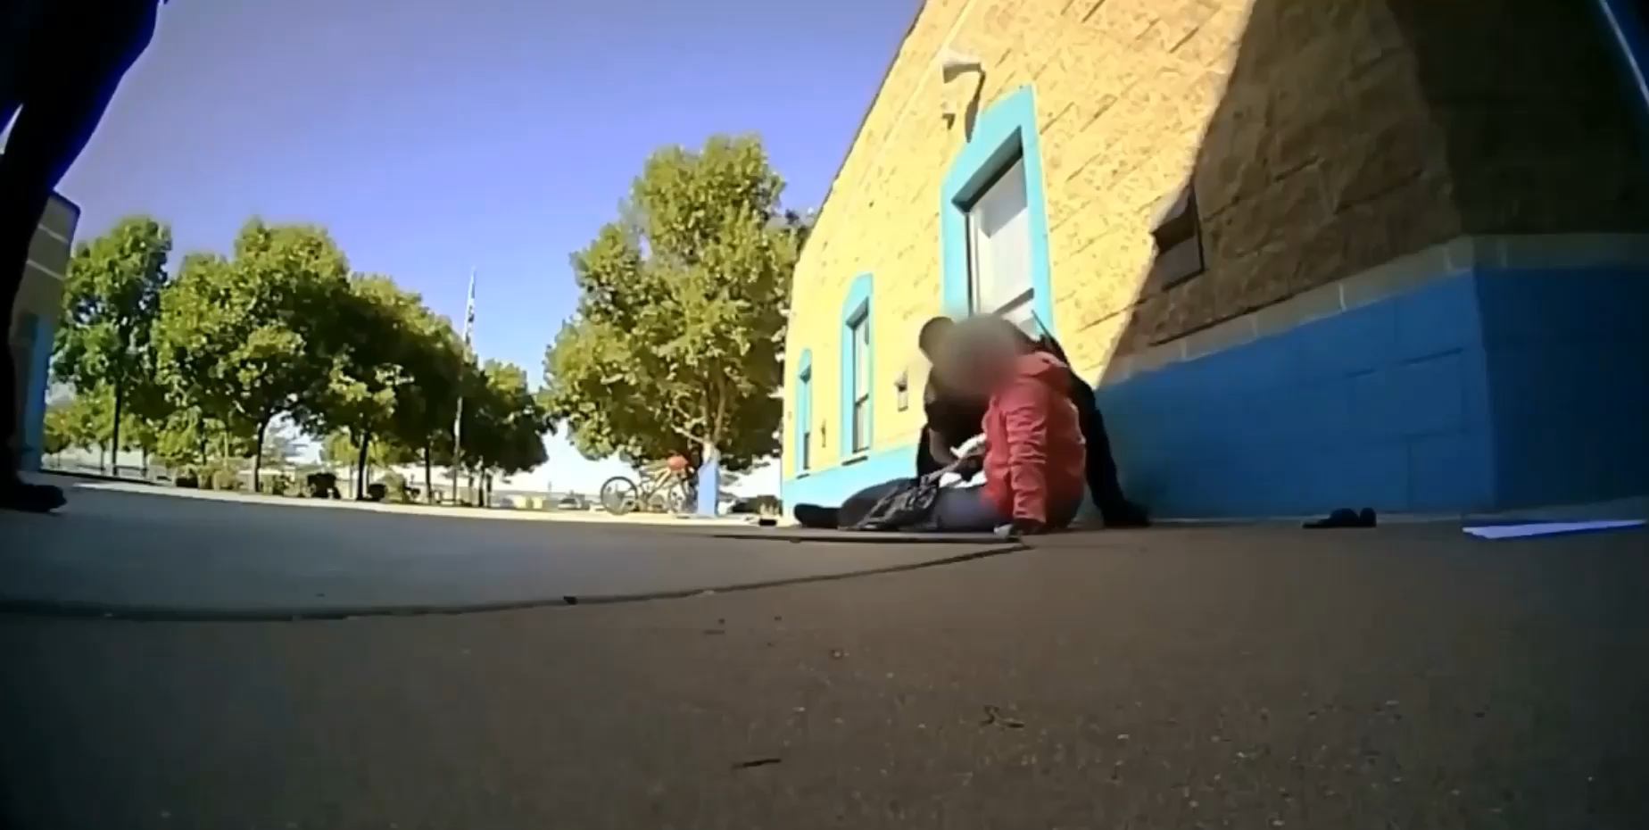
SCHOOL RESOURCE OFFICERS

Slide 21
NEW LEGISLATION
SB 1707 – Duties of School District Peace Offices
HB 3630 – Prohibiting Use of Certain Aversive Techniques on Students
SB 2135 – Threat Assessments

Slide 22
SB 1707 - Duties of school district peace officers, school resource officers, and security personnel
Bill Analysis: [Because] there is little clarity about what…officers are required to do outside of emergency situations…they often wind up participating in routine disciplinary procedures, a practice which tends to escalate such encounters unnecessarily. This practice is especially dangerous for students of color and students with special needs, who are most likely to be targeted for an intervention by a school law enforcement officer….[M]ore and more students will face unnecessary contact with these officers and with the justice system for minor disciplinary infractions.

Slide 23
SB 1707 – SROs
Prohibits districts from assigning or requiring SROs or security personnel duties that involve routine student discipline, administrative tasks, or contact with students unrelated to law enforcement duties.
Districts must adopt policies outlining the duties and expectations of security personnel and SROs.

Slide 24
SB 1707 – SROs
Input from campus behavior coordinator and other relevant district employees who deal with student behavioral issues.
Duties must be included in:
District improvement plan
Student code of conduct
Memorandum of understanding for SROs
Other campus/district documents describing the role of peace officers, SROs, or security personnel in the district

Slide 25
SB 1707 – SROs
Duties must include “protecting the safety and welfare of any person in the jurisdiction of the peace officer, resource officer, or security personnel and protecting the property of the school district.”

Slide 26
SB 1707 – SROs
Update 114
CKE(LEGAL) & (LOCAL)
CKEA – Commissioned Peace Officers
CKEB – School Marshals
CKEC – School Resource Officers

Slide 27

HB 3630 – Aversive Techniques
Prohibits school employees, volunteers, and independent contractors from using “aversive techniques” with students.
Technique or intervention that is intended to reduce a behavior by inflicting significant physical or emotional discomfort or pain.

Slide 28
HB 3630 – Aversive Techniques
Designed to or likely to cause physical pain, other than an intervention or technique permitted under Section 37.0011;
Designed to or likely to cause physical pain through the use of electric shock or any procedure that involves the use of pressure points or joint locks;
Involves the directed release of a noxious, toxic, or otherwise unpleasant spray, mist, or substance near the student’s face;

Slide 29
HB 3630 – Aversive Techniques
Denies adequate sleep, air, food, water, shelter, bedding, physical comfort, supervision, or access to a restroom facility;
Ridicules or demeans the student in a manner that adversely affects or endangers the learning or mental health of the student or constitutes verbal abuse;

Slide 30
HB 3630 – Aversive Techniques
Employs a device, material, or object that simultaneously immobilizes all four extremities, including any procedure that results in such immobilization known as prone or supine floor restraining;
Impairs the student’s breathing, including:
(A) applying pressure to the student’s torso; or
(B) obstructing the student’s airway, including placing an object in, on, or over the student’s mouth or nose or placing a bag, cover, or mask over the student’s face;

Slide 31
HB 3630 – Aversive Techniques
Restricts the student’s circulation;
Secures the student to a stationary object while the student is in a sitting or standing position;
Inhibits, reduces, or hinders the student’s ability to communicate;

Slide 32
HB 3630 – Aversive Techniques
Involves the use of a chemical restraint;
Constitutes a use of timeout that precludes the student from being able to be involved in and progress appropriately in the required curriculum and, if applicable, toward the annual goals included in the student’s IEP, including isolating the student by the use of physical barriers.

Slide 33
HB 3630 – Aversive Techniques
Except as provided by (d-2), deprives the student of the use of one or more of the student’s senses
(c) An aversive technique may be used if the technique is executed in a manner that:
(1) does not cause the student pain or discomfort; or
(2) complies with the student’s IEP or BIP.

Slide 34

Technique or intervention that is intended to reduce a behavior by inflicting significant physical or emotional discomfort or pain.

Slide 35
SB 2135 – Threat Assessments
Requires law enforcement officials to provide superintendent/designee information about a student’s arrest to enable school to conduct threat assessment or prepare a safety plan related to the student.

Slide 36
PTAC-FAQ-11, February 2019

Slide 37
THREAT ASSESSMENT TEAMS
PTAC-FAQ-11, February 2019

Slide 38
School official with legitimate educational Interest
Annual notification of FERPA rights
Non-disclosure; prohibits redisclosure
Exceptions: health & safety emergencies
Documentation of disclosures - exceptions

Slide 39
LITIGATION
Wilson v. City of Southlake, 936 F.3d 326 (5th Cir. 2019).
Parents sued city, police department, and SRO.
MOU between city and school district: city provides training, vehicle, equipment; school provides detailed instructions and access to BIPs, ARD paperwork, and IEPs to SRO before requesting assistance.
Second grader; AU, ODD, separation anxiety disorder; 87 lbs; 58” tall.
Jan. 7, 2014: In principal’s office, S.W. screamed obscenities at principal, overturned chairs, punched and kicked principal; threw a jar of beans, said going to kill someone, and “eventually dropped his pants and exposed himself.” Calmed down; parents took home; SRO notified.
Jan. 23, 2014: In principal’s office, obscenities, crumpling papers, throwing items on floor, referenced homemade nun chucks (jump rope provided by school for Jump Rope for Heart.

Slide 40
LITIGATION
Wilson v. City of Southlake, 936 F.3d 326 (5th Cir. 2019).
SRO’s police vehicle recorded these exchanges. The parties do not contest these particular facts.
AP calls for SRO, “stand and watch right here, say nothing.”
^{SRO handcuffs S.W.}
“Punk” and “brat,” mocked S.W. and laughed at him.
^{Mother – traumatizing}
SRO, “You know what? You’re right, I don’t know that. I’m not a psychologist.” “[H]e has no sign on his head that says, ‘I have autism, I hit people.’” “Great parenting!”
^{SRO terminated by city.}
Parents sued city, PD, and SRO for discrimination under 504 and ADA.
District court granted summary judgment for all defendants; 5th Circuit reinstated claims against SRO.

Slide 41
LITIGATION
Washington v. Kathy Indep. Sch. Dist., __ F.Supp.3d__, 2019 WL 4194118 (5th Cir. 2019).
Mother sued school district after son tasered and handcuffed when trying to leave school building.
Emotional and intellectual disabilities requiring special education
^{SRO knew part of PASS group.}
Claim: failed to provide a safe and non-hostile environment and refused to permit him to leave the campus as they would have otherwise permitted a nondisabled student to do so, solely because of his disability.
Claims dismissed because no proof that SRO was discriminating against him because of his disability, even if treating him differently.
Evidence showed that desire was to keep him safe from the vulnerabilities his disabilities caused.

Slide 42

Additional Resources
SECURe – Safe School-based Enforcement through Collaboration, Understanding, and Respect
Texas Association of School Resource Officers
Texas School Safety Center

Slide 43

www.edlaw.com

